Slide 1
How To Improve
Your Mile
By: Nathan Chiang, Robert Reid, Yuseph Ali, Faustino Altamirano, Kyle Eckert, Bradley Iverson

Slide 2
Stay away from Junk Food
Junk food is food that is calorie-dense and nutrient poor.
Junk food plays a major role in the obesity epidemic.
Processing that removes vitamins, minerals and fiber turns junk food into a calorie packed nutritionless food

Slide 3
Eat Healthy
Eating a healthy, balanced diet provides nutrients to your body.
Nutrients also help build and strengthen bones, muscles, and tendons and also regulate body processes, such as blood pressure.

Slide 4
Run as Often as Possible
Running will help you discover what your pace and average speed is.
Helps you develop stronger leg strength and core build up.
A great way to lose weight.
We all want that Summer body!!!

Slide 5
Stay Hydrated
Drinking water before and after a run will help keep your body hydrated.
It will cool your body temperature down.
It will also prevent dehydration.
Helps regulate oxygen and blood flow.

Slide 6
Cardio Exercises
Cardio will help strengthen your body
It will help you build a stronger core.
Will strengthen your diaphragm which will help you regulate your breathing during a run.
Stretches and loosens up your muscles and body.

Slide 7
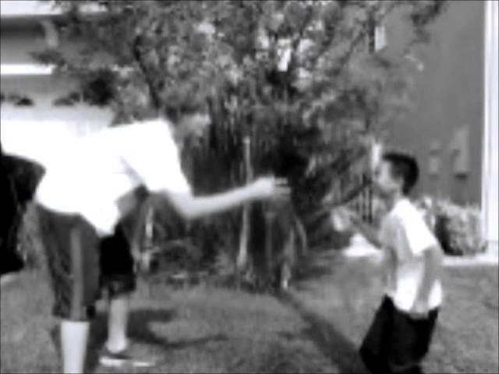
In Summary:

