Slide 1
Ways to Improve Your Mile Time
By:
Christian Checa
Kenneth Woo
Cameron Melton
Diamond Aguilar
Kyle Montes

Slide 2
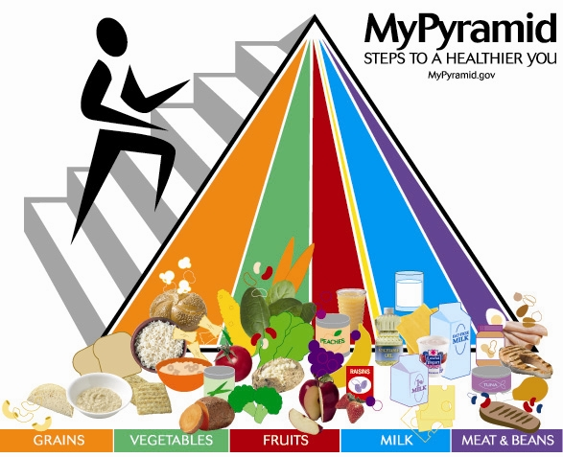
Eat Right
A balanced diet is essential to staying healthy and fit.
Make sure to get the essential nutrients that your body needs.
Add a healthy serving of fruits and vegetables to each meal.

Slide 3
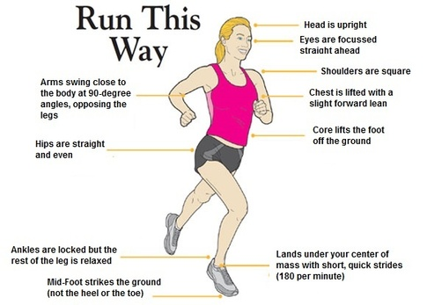
Start Training
Do exercises to improve your endurance
Fix your running technique
Improve your breathing techniques
Hire a personal trainer if necessary

Slide 4
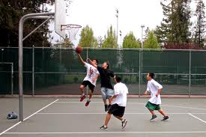
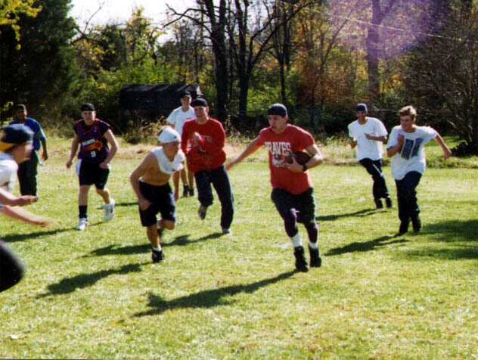
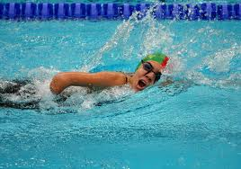
Go Out
Get your body moving!
Play sports or do any physical activity
Get together with friends and have fun

Slide 5
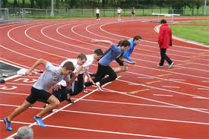
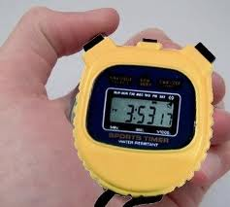
Keep Track
Keep track of every run you do
Aim to make improve by one second each time
Always push yourself and never give up

Slide 6
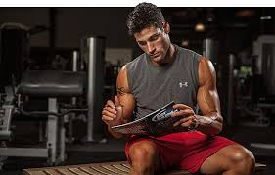
Make A Plan
Set up a weekly plan to improve your physical fitness
Change it up each day to exercise all of your body
Research different methods to stay fit

Slide 7
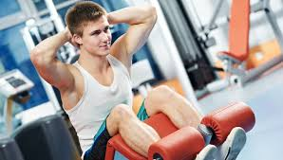
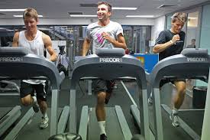
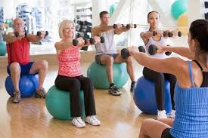
Work Out
Go to the gym and work out
Work out your upper and lower body
Improve abdominal muscles to strengthen your core.

Slide 8
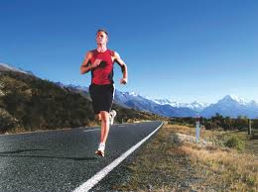
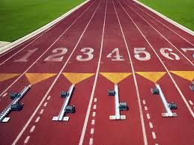
Run!
Continuously running will only improve your time
Try short distance sprints to improve speed
Go for long distance runs to improve endurance

